Slide 1
MAXIMIZING ENROLLMENT BY MAXIMIZING YOUR BUDGET
marketing@thirdwavedigital.com
888.578.7865
twdcampustours.com

Slide 2
SET YOUR MARKETING UP FOR SUCCESS
What do you use to manage and track your leads?
CRM
Master Spreadsheet
Who is involved in the process?
Marketing
Admissions

Slide 3
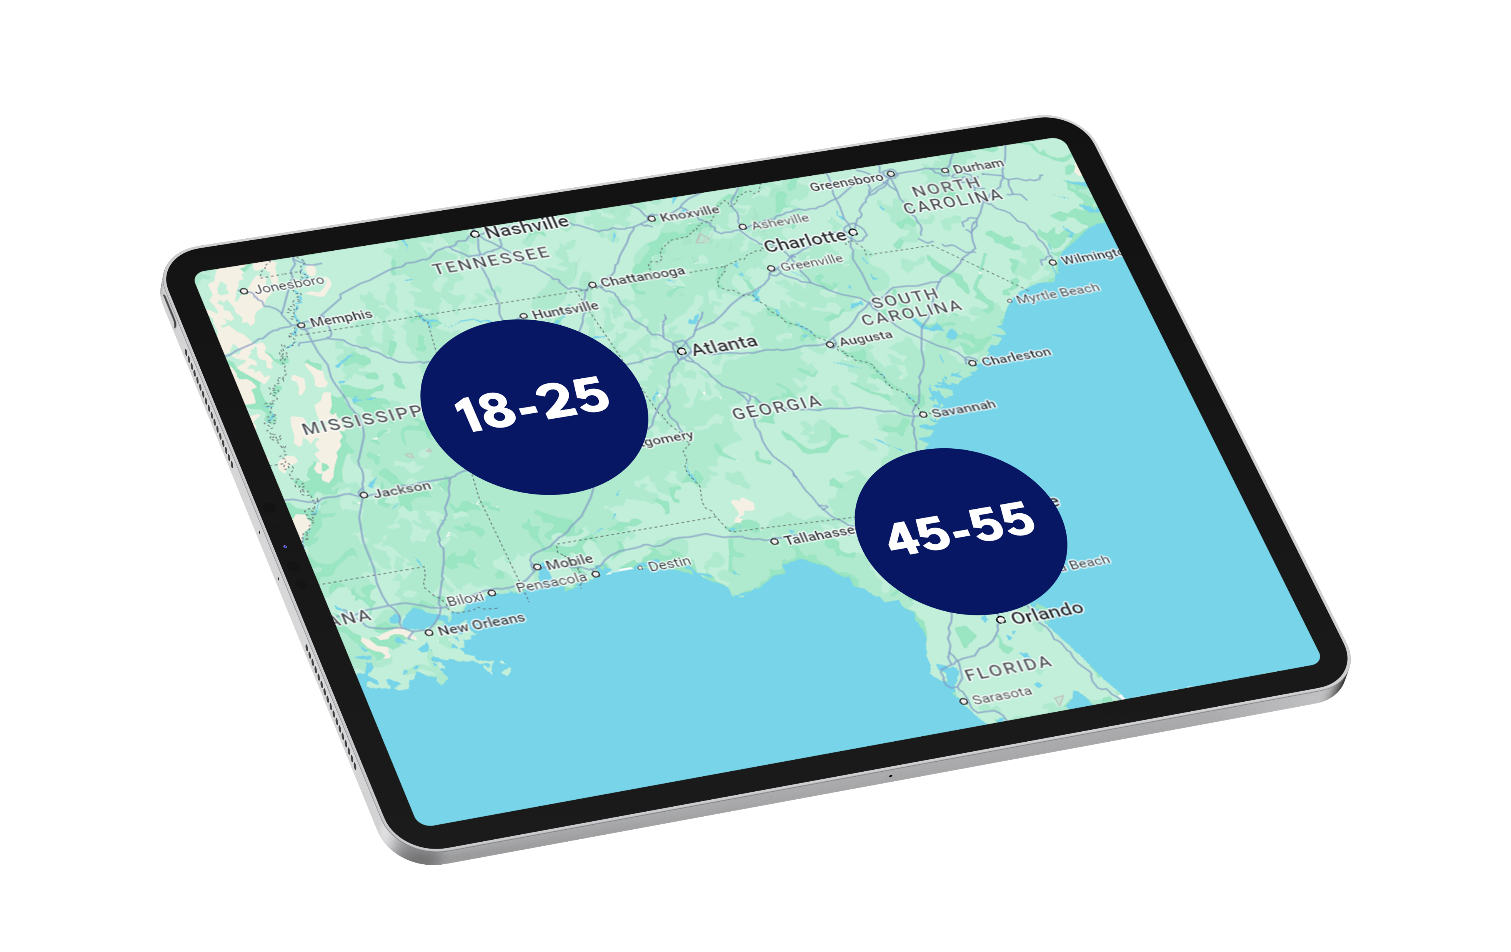
BACK TO MARKETING 101
Know your College’s Target Audience
01
Geographic Targeting
Demographic Targeting
Interest Targeting
Things to Consider
02
Younger vs Older Enrollment Ages
Growing Demographics
Budget Planning Factors
03
Emerging Demographics
Core Demographics

Slide 4
ANALYTICS DON’T LIE
CAMPAIGN OBJECTIVES
Measured by CPC
(Cost per Click)
Measured by CPM
(Cost per Thousand)
Measured by CPL
(Cost per Lead)
Traffic/Awareness
Comparing Performance Between Digital & Traditional
Lead Generation

Slide 5
WHY WE PLACE
WHY TRADITIONAL?
WHY DIGITAL?
BRAND AWARENESS
LEAD GENERATION
Increases Brand Recognition
Tracking Results - ROI
Reaches Wider Audience
Follow the Person
Organic Foundation
Easy to Capture a Lead

Slide 6
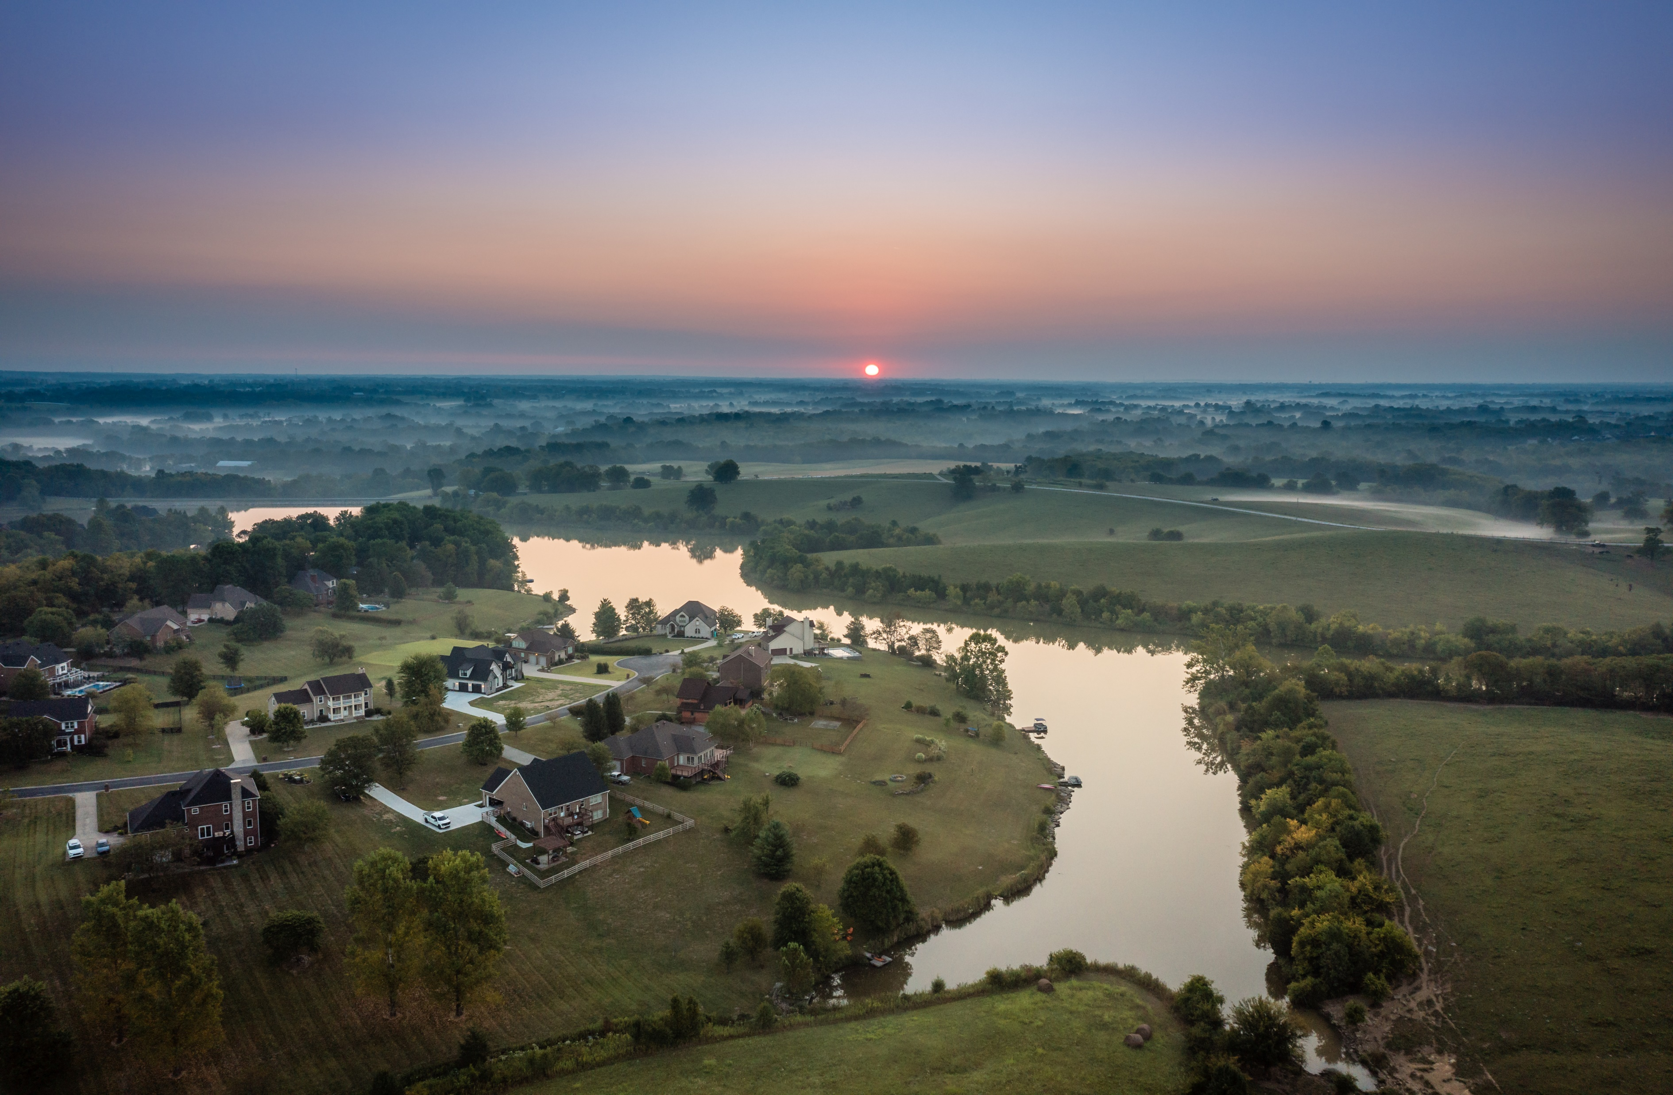
WHERE WE PLACE
TRADITIONAL MEDIA
BRAND AWARENESS
TV
35+ audience
Rating Points
Rate vs CPM
Radio
High Frequency
Demographic Reach
Versatility
Billboards
Directional Placement
Evergreen Awareness Campaigns

Slide 7
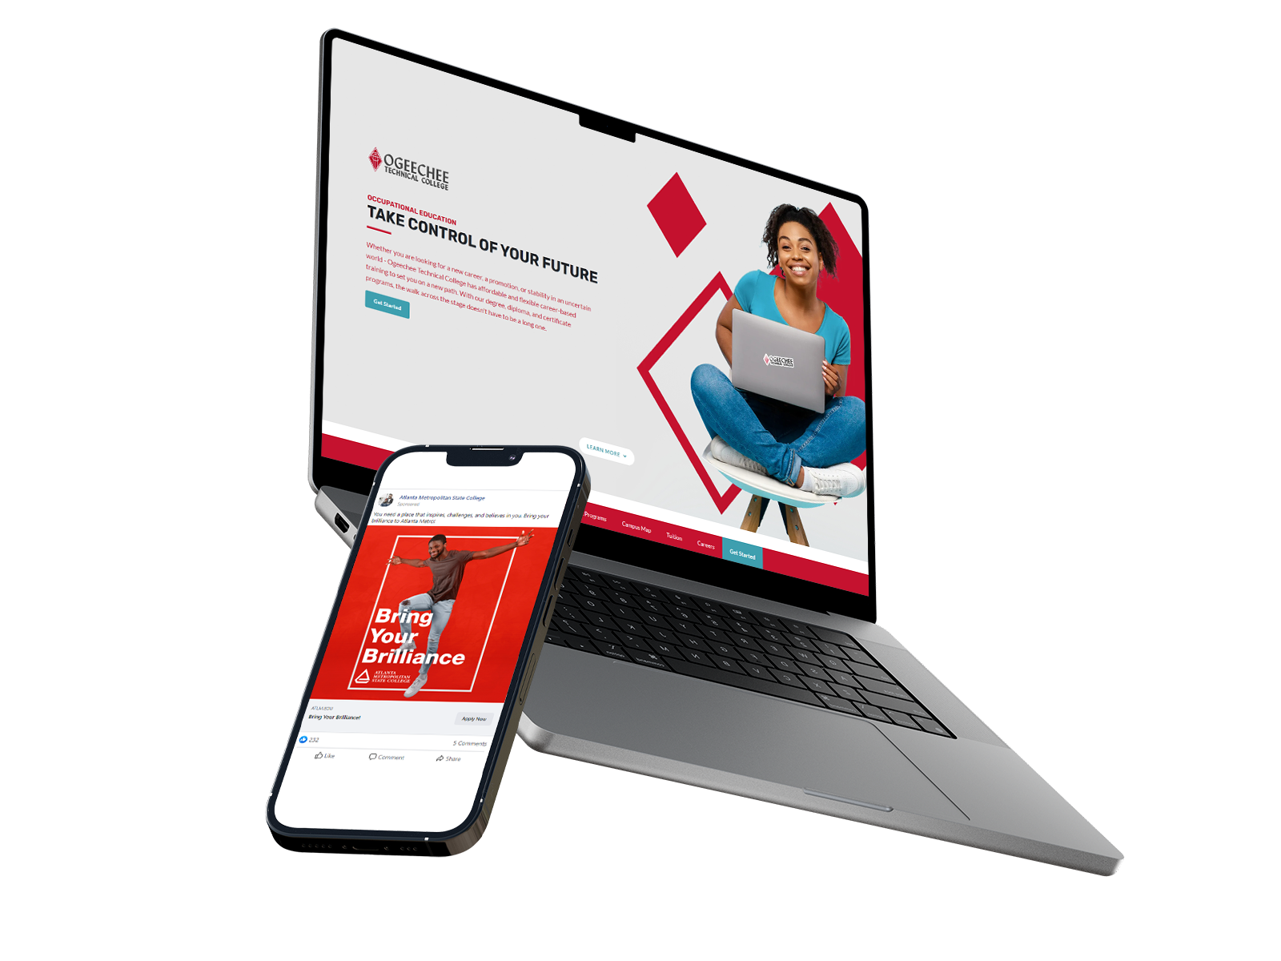
WHERE WE PLACE
DIGITAL MARKETING
LEAD GENERATION
Meta
Lookalike campaigns
Boosting is not an ad
Tracking pixels
Google
Performance Max campaigns
Demand Gen campaigns
Tracking pixels
YouTube
Digital Audio
Granular Targeting
Complement Traditional TV but trackable
Multiple Placement Options
Better Targeting than Traditional Radio
Audio with a Display Graphic
More Analytics

Slide 8
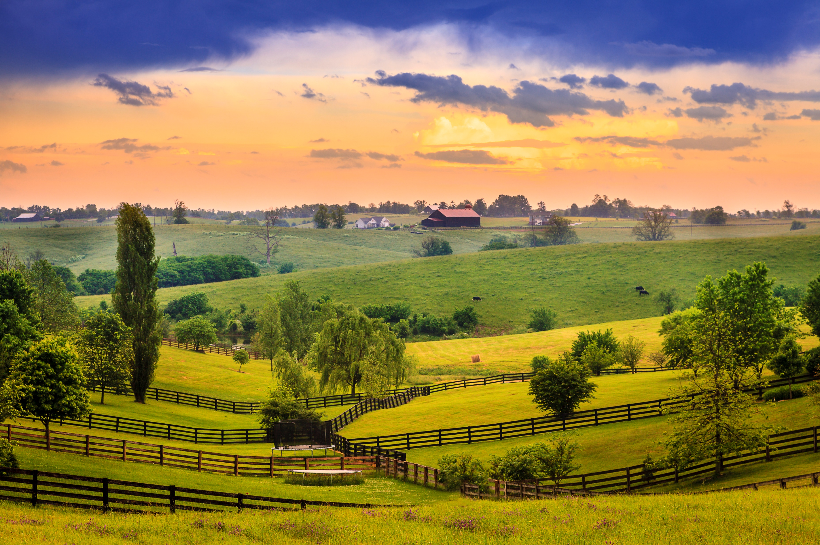
“Hot” Platforms
Twitch, OTT, etc.
Billboards
All Branding No Lead Generation
Pros and Cons
Targeting a Needed Demo
Untested and Higher Costs
Educate Yourself so You Can Educate Others
“WHAT MY
WANTS”
(Non marketing person)

Slide 9
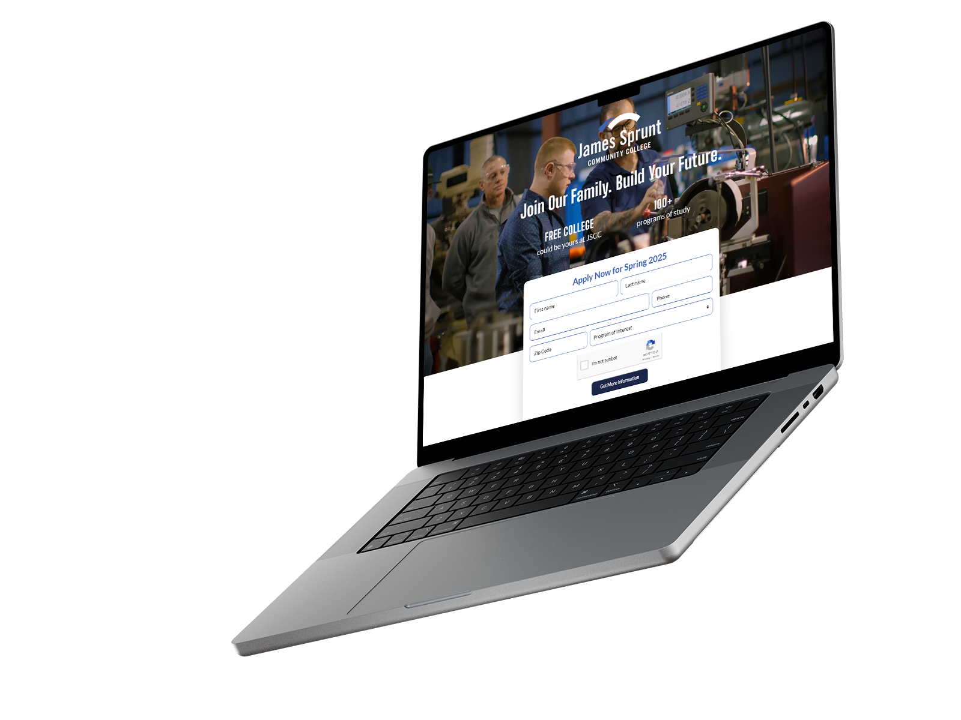
OTHER ITEMS TO KEEP IN MIND FOR BUDGETING
Digital Marketing Landing Pages
Website Redesigns & Updates
Video Production
& Creative
Print & Miscellaneous

Slide 10
WAYS TO
MAXIMIZE BUDGET
Utilize Grants
Perkins funds
In-house Social Media Management and Graphic Design
Strategic Placement
Traditional
TV/Radio: Lower budget during non-enrollment periods
Digital Billboard vs Vinyl
Added Value and Rate Negotiation
Digital
Learning phase
Lower budget during non-enrollment periods

Slide 11
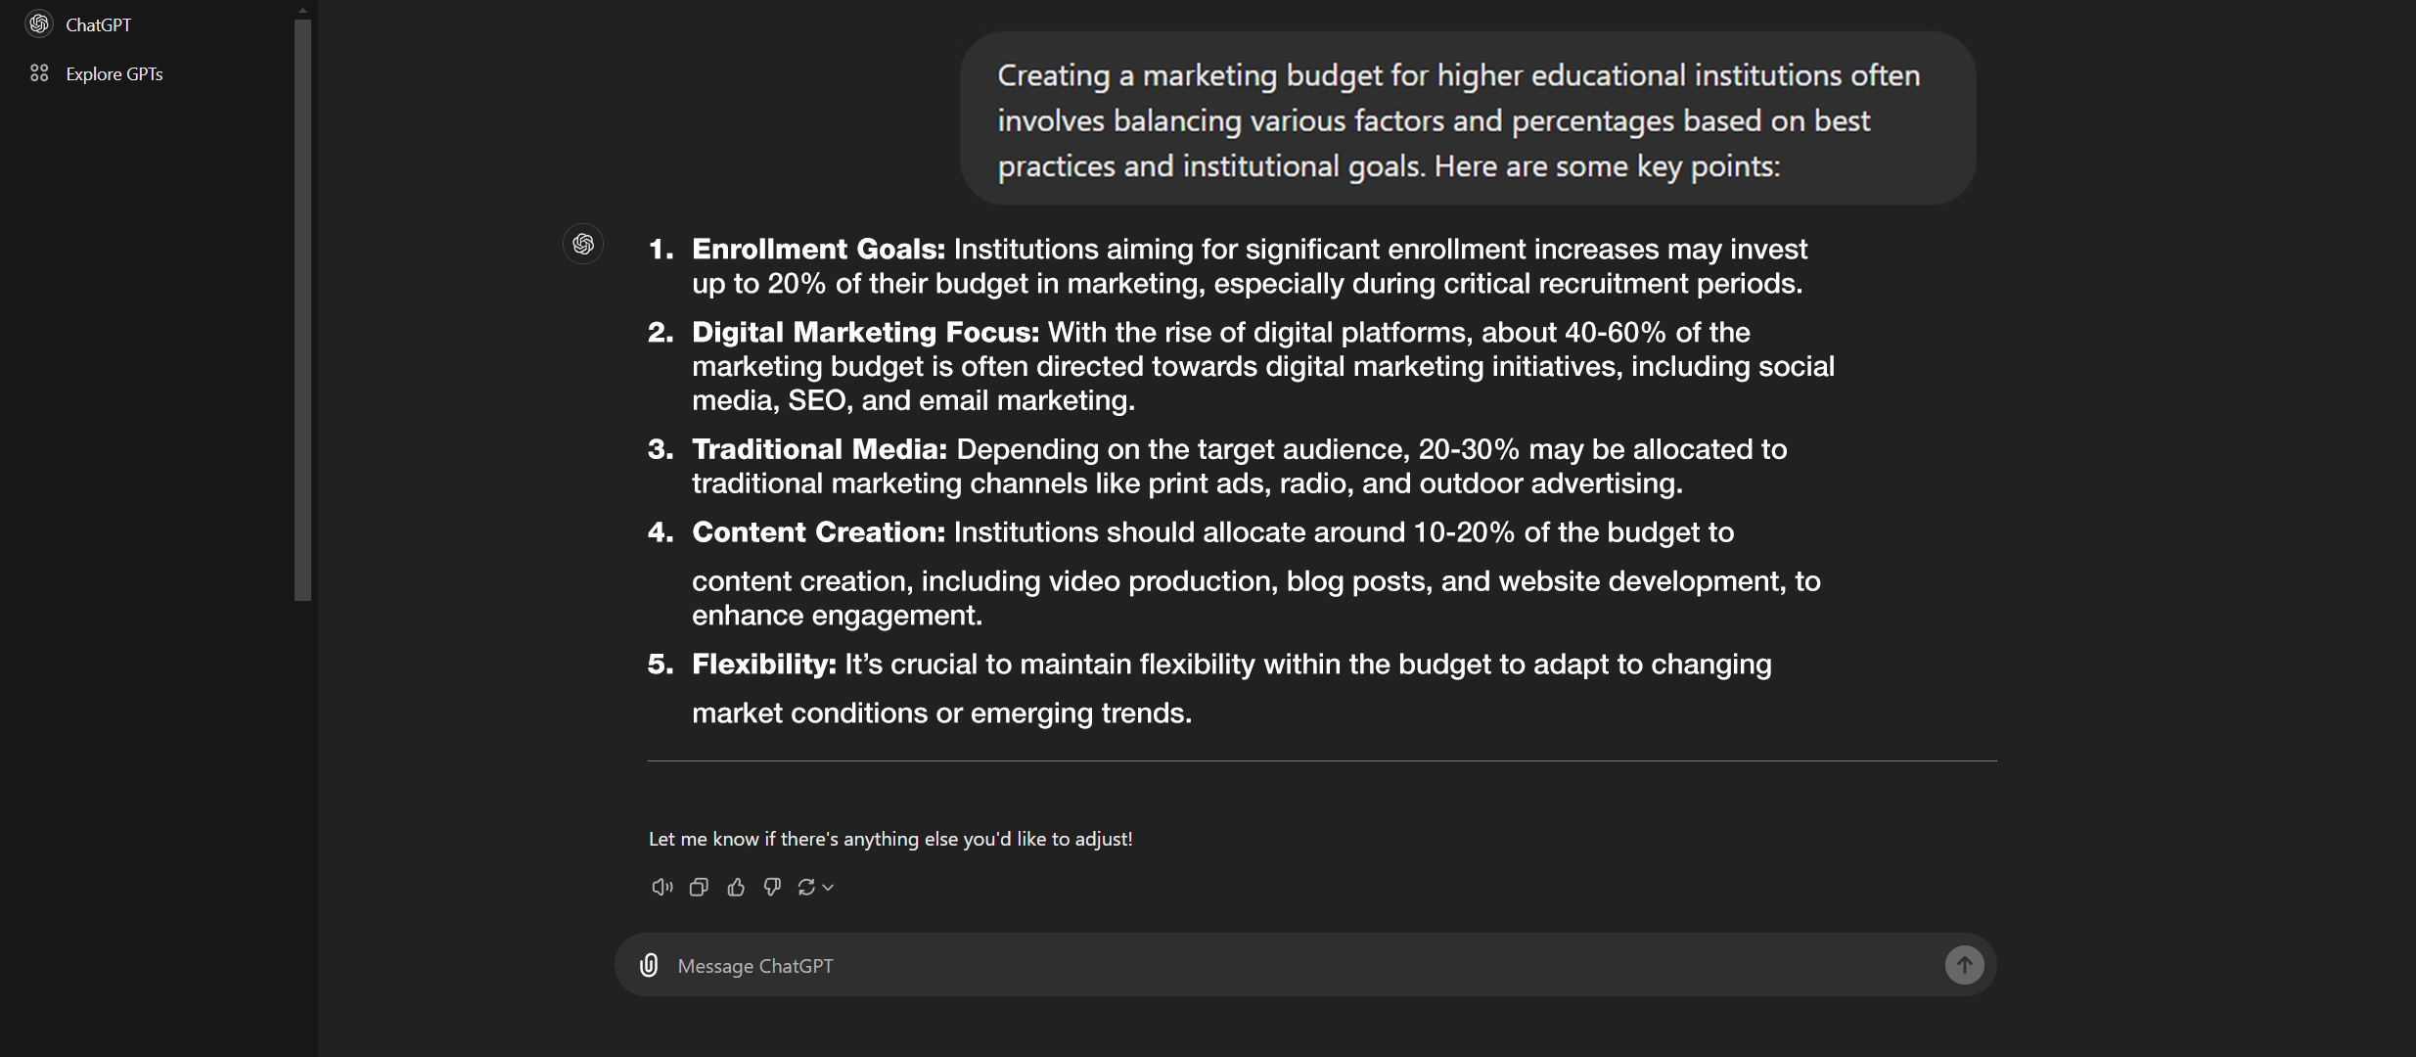
WHAT CHATGPT SAYS

Slide 12
EXAMPLE PLACEMENT
BUDGET

Slide 13
RESULTS SPEAK LOUDER THAN WORDS
“
Average
Enrollment Growth
9.3%
“GNTC’s advertising strategy has transitioned to mostly digital platforms, including social media, video streaming, websites, search engine optimization, lead generation and content marketing.”
- Amber Jordan, Director of Marketing and Public Relations at GNTC
10%
10%
11%
12%

Slide 14
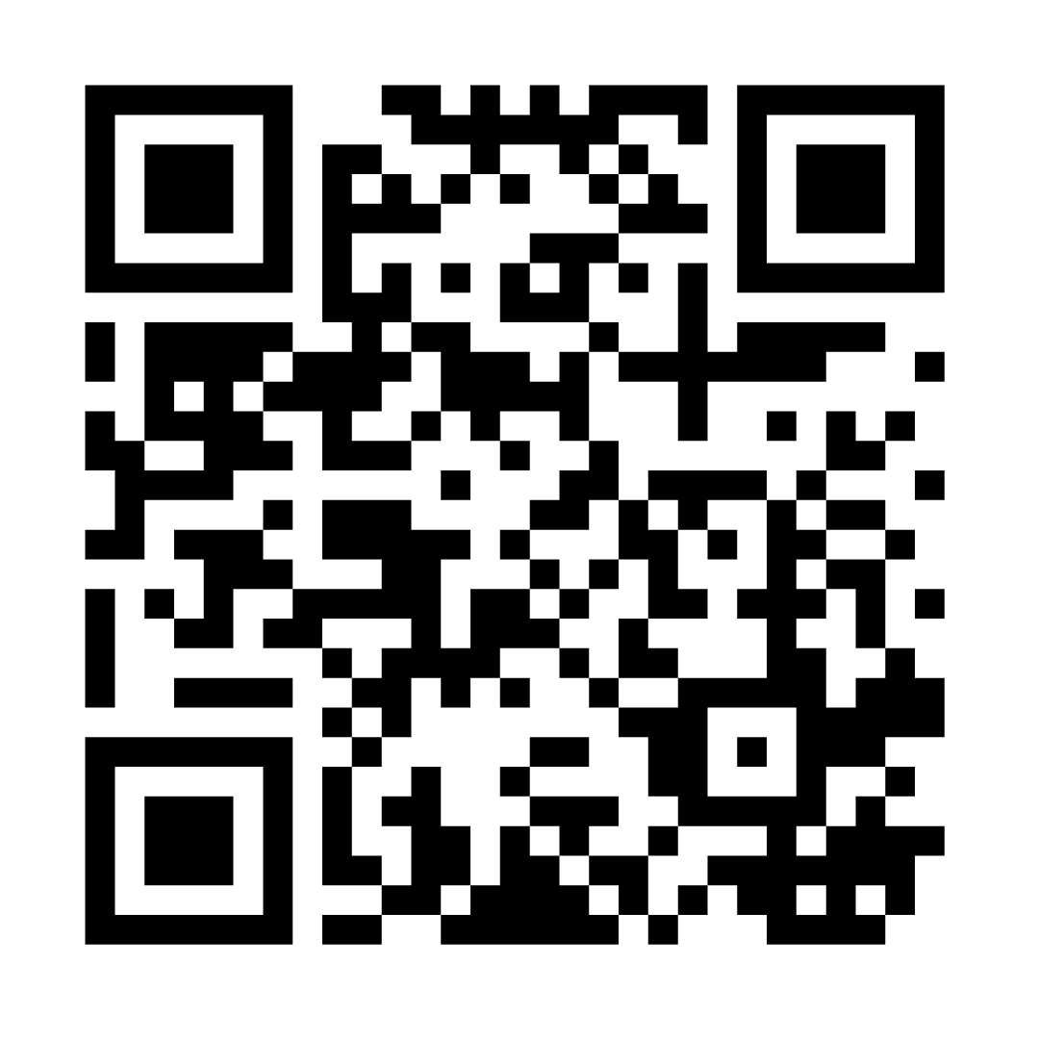
DOWNLOAD THE PRESENTATION
THANK YOU
marketing@thirdwavedigital.com
888.578.7865
twdcampustours.com

